Slide 1
Markets: Part 2
Monopoly,Monopolistic Competition &Oligopoly

Slide 2
Total, Marginal& Average Revenue
Price | Quantity | Total Revenue | Marginal Revenue | Average Revenue
Rs6 | 0 | 0 | -
5 | 1 | 5 | 5 | 5
4 | 2 | 8 | 3 | 4
3 | 3 | 9 | 1 | 3
2 | 4 | 8 | -1 | 2
1 | 5 | 5 | -3 | 1

Slide 3
Monopolist’s Demand Curve
P*
Rs
1 5 10
Quantity

Slide 4
Monopolist’s Demand Curve
P*
Rs
D or AR
1 5 10
Quantity

Slide 5
Monopoly Price, Quantity, and Revenue Schedules

Slide 6
Monopoly
Rs
22
18
14
10
6
2
1 5 10
Quantity

Slide 7
Monopoly
Rs
22
18
14
10
6
2
AR or D
1 5 10
Quantity

Slide 8
Monopoly
The monopolist's demand curve
  downward sloping
    the greater the market power, the less elastic the demand curve(Average Revenue)
  MR below AR ((Demand)
Equilibrium price and output
  Equilibrium output, where MC = MR
  Equilibrium price, found from D curve
Profit
  Measuring profit
Notes:
8

Slide 9
Monopoly
Rs
22
18
14
10
6
2
D or AR
MR
1 5 10
Quantity

Slide 10
Monopoly
Rs
22
18
14
10
6
2
MC
AR
MR
1 5 10
Quantity

Slide 11
Monopoly
Rs
22
18
14
10
6
2
MC
ATC
AR
MR
1 5 10
Quantity

Slide 12
Monopoly
Costs / Revenue
AR (D) curve for a monopolist likely to be relatively price inelastic. Output assumed to be at profit maximising output (note caution here – not all monopolists may aim for profit maximisation!)
Given the barriers to entry, the monopolist will be able to exploit abnormal profits in the long run as entry to the market is restricted.
This is both the short run and long run equilibrium position for a monopoly
MC
Rs7
Monopoly
Profit
AC
Rs 3
MR
AR
Output / Sales
Q1

Slide 13
Monopoly
Rs
22
18
14
10
6
2
MC
ATC
AR
MR
1 5 10
Quantity

Slide 14
Monopoly
Pure monopoly – where only one producer exists in the industry
In reality, rarely exists – always some form of substitute available!
Monopoly exists therefore where one firm dominates the market
Use term ‘monopoly power’ with care!

Slide 15
Price Discrimination
Act of charging different prices for the same or slightly differentiated products

Slide 16
Types of price discrimination
Price discrimination.
First-degree: the firm is aware of each buyer’s demand curve
Second-degree: the firm charges a different price, depending on the quantity each buyer purchases
Third-degree: the firm breaks buyers into groups based upon their price elasticity of demand

Slide 17
First Degree Price Discrimination
(Perfect Price Discrimination)
Price discrimination.
Each consumer is charged the price he/she is willing to pay.
Producer takes all the consumer surplus

Slide 18
2nd Degree Price Discrimination
(non-linear pricing)
Price discrimination.
Different price is charged for a different quantity bought (but not across consumers).
set one price for a 1st bundle, a lower price for a 2nd bundle, ....
extract some, but not all of consumer surplus
Note:
In 1st deg case: different prices charged for different consumers
In 2nd deg case: different prices charged for different quantities (for same consumer)

Slide 19
2nd Degree Price Discrimination
(non-linear pricing)
Price discrimination.
Examples:
Telephone companies charging different prices for
different quantities
A single pack of t shirt may cause you 100, but a pack of three would cost you only 175.

Slide 20
3rd Degree Price Discrimination
Practice of dividing consumers into two or more groups with separate demand curves and charging different prices to each group
Eg: regular versus special airline fares, premium versus non premium brands of liquor, canned food or frozen vegetables, discounts to senior citizens & students

Slide 21
Monopolistic Competition
Large no: of buyers & sellers
Differentiated products
Relevance of Advertisement/selling costs

Slide 22
Monopolistic Competitor Demand Curve
Rs
AR
1 5 10
Quantity

Slide 23
Monopolistically Competitive SR
Rs
22
18
14
10
6
2
AR
1 5 10
Quantity

Slide 24
Monopolistically Competitive SR
Rs
22
18
14
10
6
2
AR
MR
1 5 10
Quantity

Slide 25
Monopolistically Competitive SR
Rs
22
18
14
10
6
2
MC
AR
MR
1 5 10
Quantity

Slide 26
Monopolistically Competitive SR
Rs
22
18
14
10
6
2
MC
ATC
AR
MR
1 5 10
Quantity

Slide 27
Monopolistically Competitive SR
Rs
22
18
14
10
6
2
MC
ATC
AR
MR
1 5 10
Quantity

Slide 28
Monopolistically Competitive SR
Rs
22
18
14
10
6
2
MC
ATC
AR
MR
1 5 10
Quantity

Slide 29
Monopolistically Competitive SR
Rs
22
18
14
10
6
2
MC
ATC
AR
MR
1 5 10
Quantity

Slide 30
Monopolistically Competitive Firm’s Price, Quantity, and Profit
Long Run

Slide 31
Monopolistically Competitive LR
Rs
22
18
14
10
6
2
1 5 10
Quantity

Slide 32
Monopolistically Competitive LR
Rs
22
18
14
10
6
2
AR
1 5 10
Quantity

Slide 33
Monopolistically Competitive LR
Rs
22
18
14
10
6
2
AR
MR
1 5 10
Quantity

Slide 34
Monopolistically Competitive LR
Rs
22
18
14
10
6
2
MC
AR
MR
1 5 10
Quantity

Slide 35
Monopolistically Competitive LR
Rs
22
18
14
10
6
2
MC
ATC
AR
MR
1 5 10
Quantity

Slide 36
Monopolistically Competitive LR
Rs
22
18
14
10
6
2
MC
ATC
AR
MR
1 5 10
Quantity

Slide 37
Oligopoly Markets

Slide 38
CHARACTERISTICS OF OLIGOPOLY
A Few Large Producers
Homogeneous or Differentiated Products
Control over Price, but Mutual Interdependence
Entry Barriers

Slide 39
Oligopoly
Price war
Price rigidity
Kinked demand curve
Price signaling
Price leadership
Collusion-Cartels
  OPEC –oil cartel, CIPEC-copper cartel

Slide 40
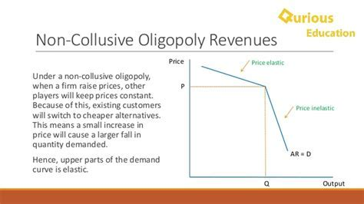

Slide 41
Oligopoly
Factors favouring collusion
  Few firms
  Open with each other
  Similar production methods and average costs
  Similar products
  Dominant firm
  Significant entry barriers
  Stable market
  No government measures to curb collusion

Slide 42
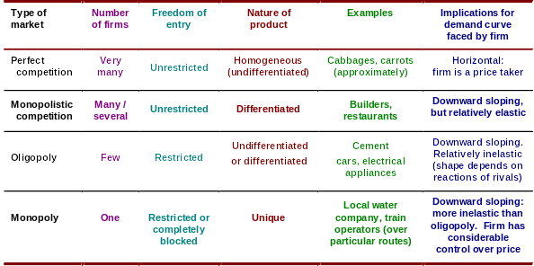
Features of the four market structures

Slide 43
Features of the four market structures

Slide 44
Features of the four market structures

Slide 45
Features of the four market structures

Slide 46
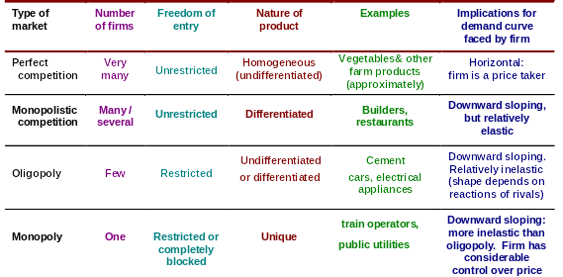
Features of the four market structures

Slide 47
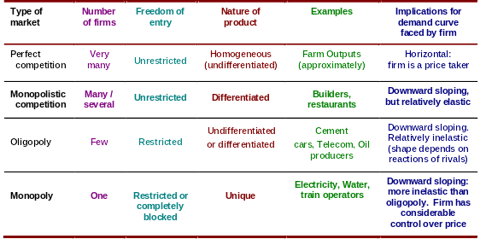
Features of the four market structures

